Slide 1
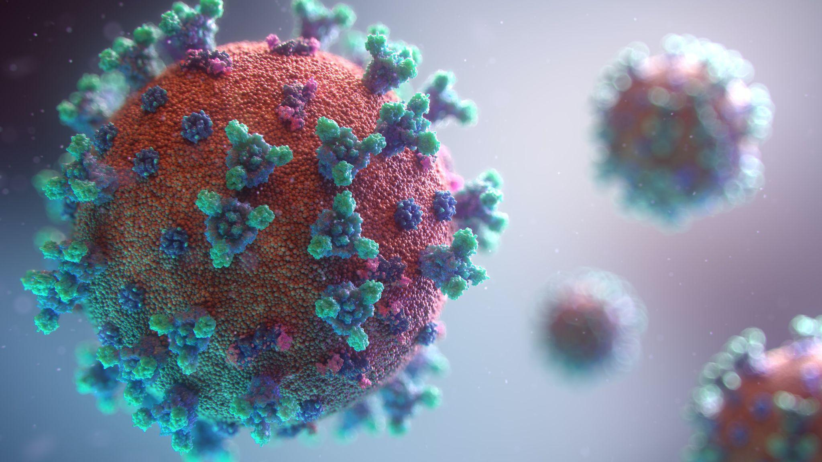
Photo by Fusion Medical Animation on Unsplash

Slide 2

Photo by Andrew Neel on Unsplash

Slide 3
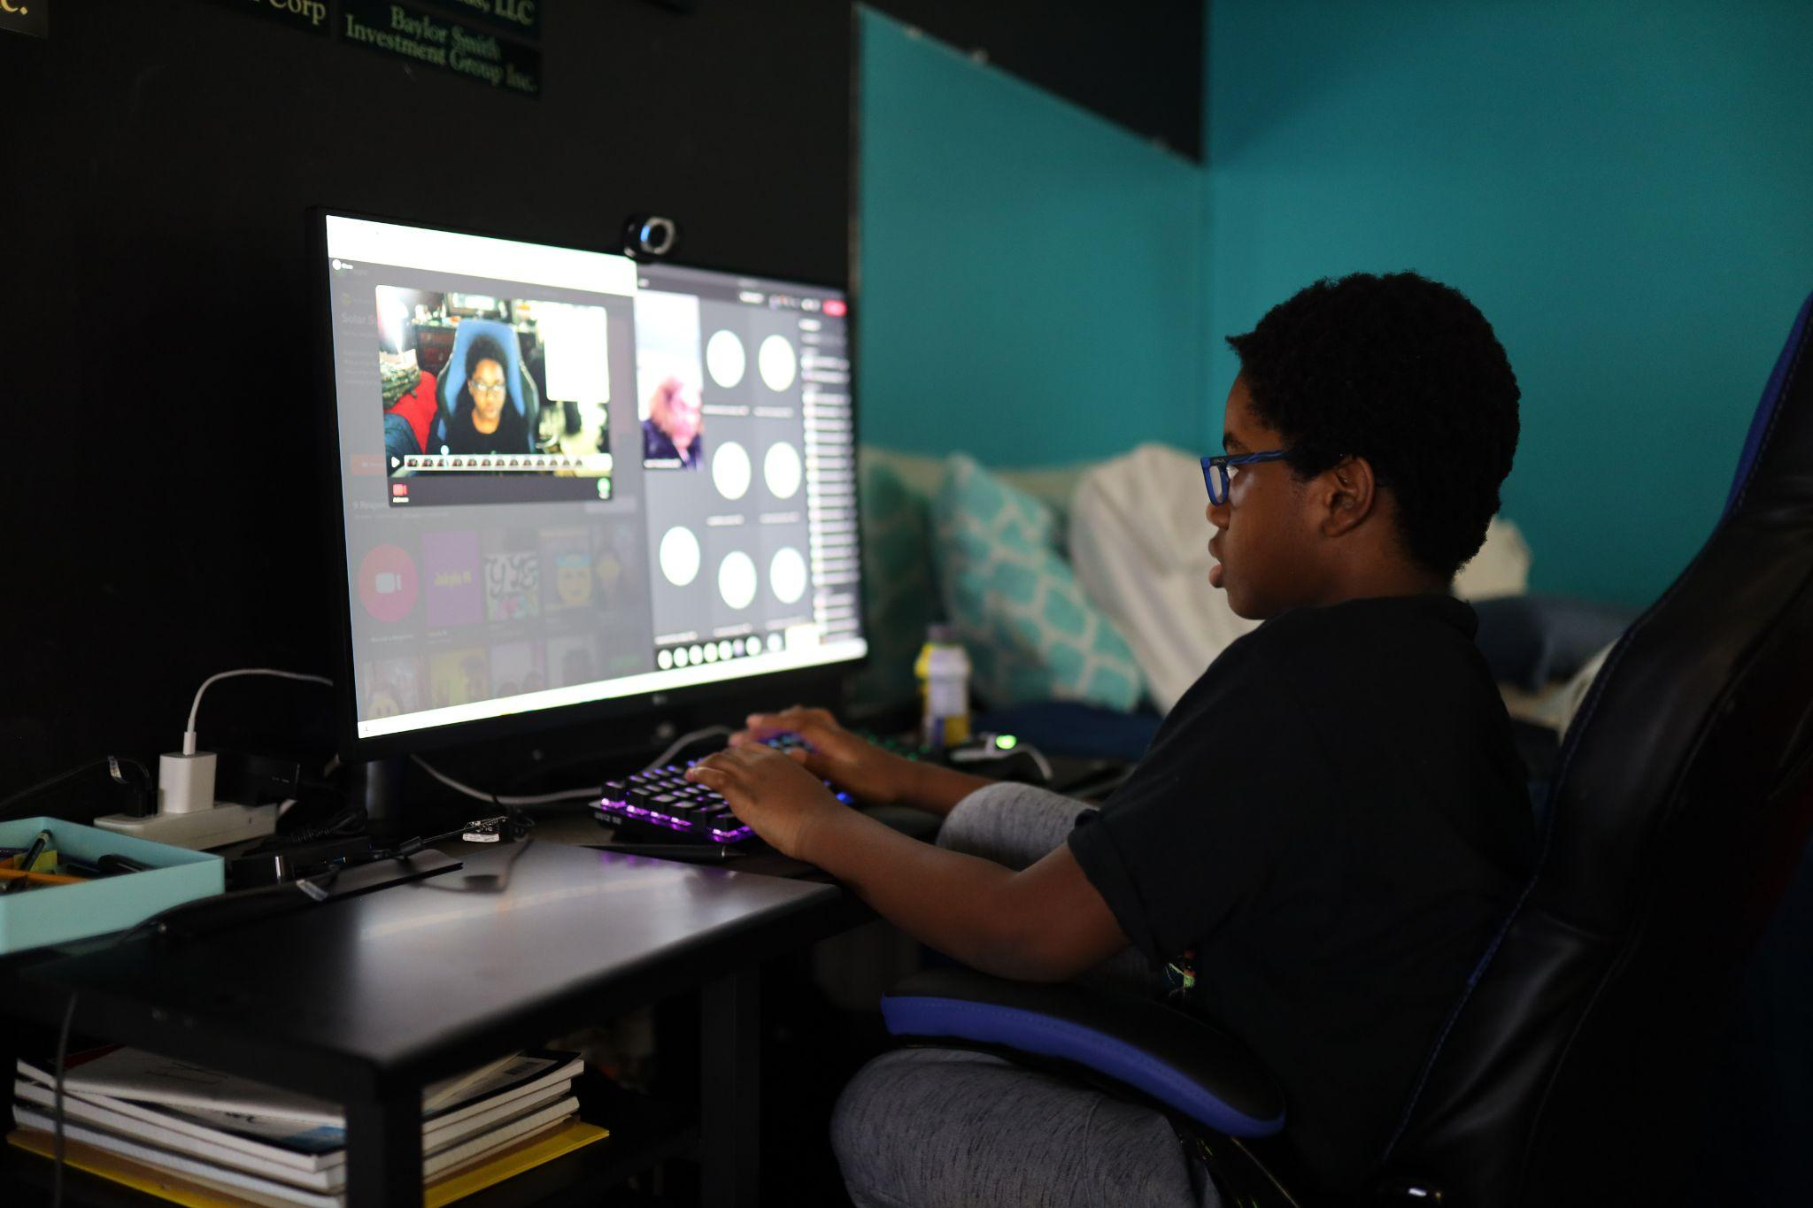
Photo by Ralston Smith on Unsplash

Slide 4
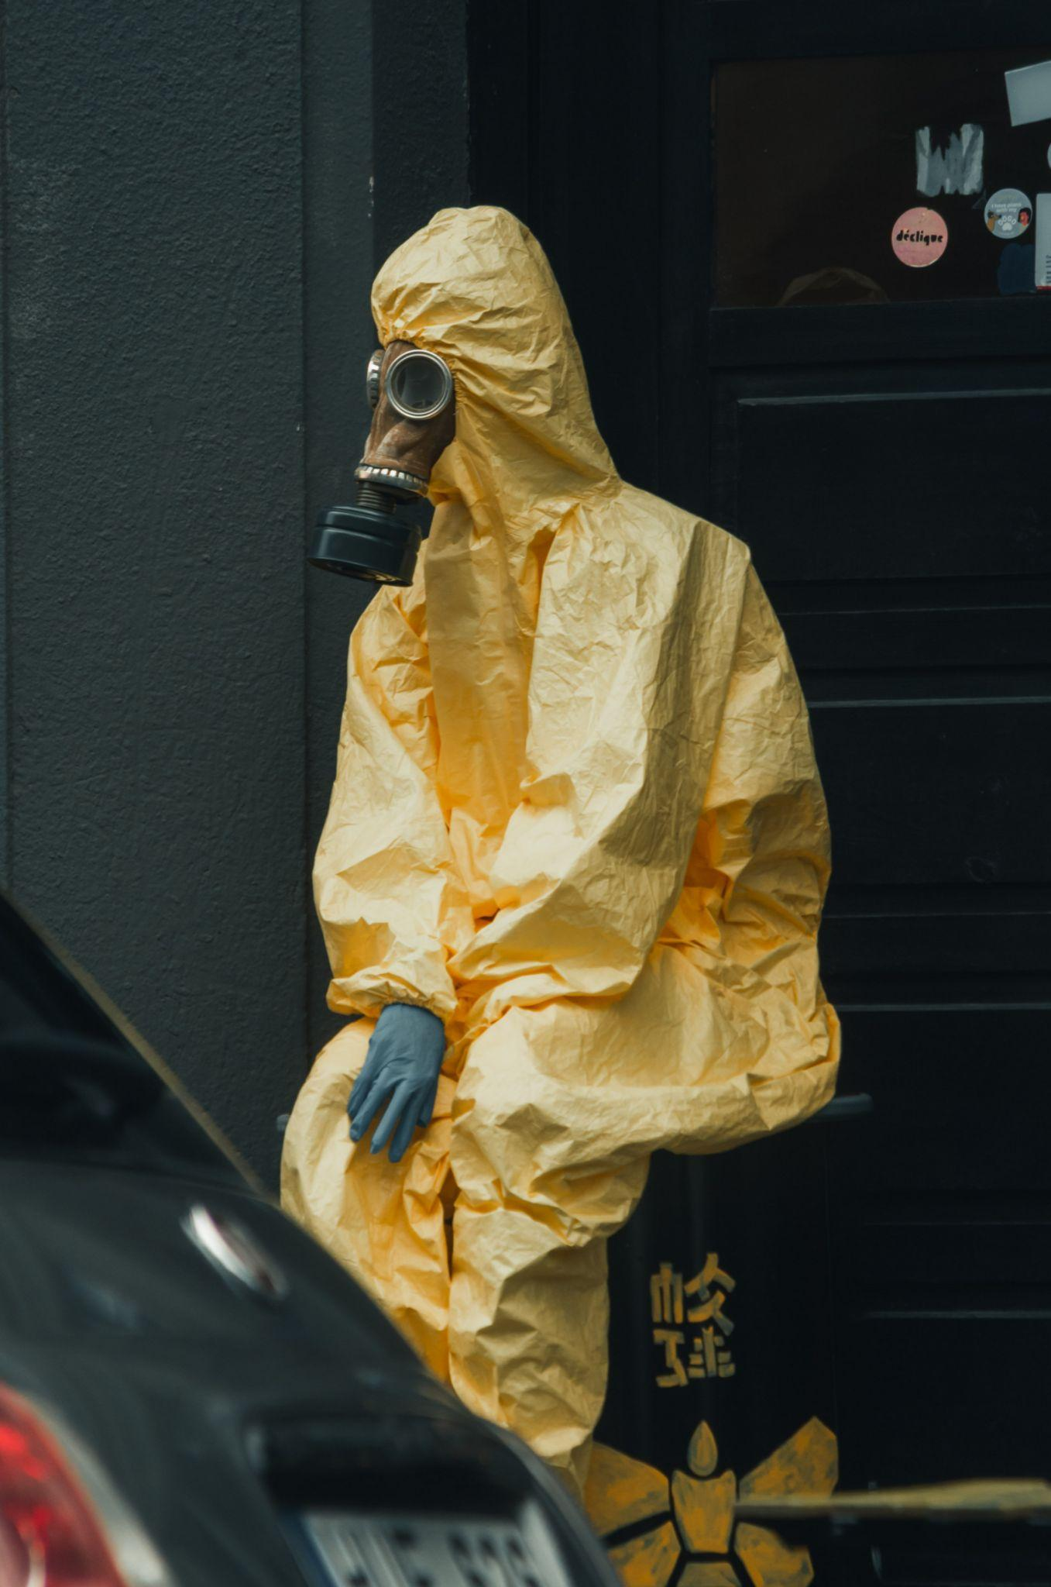
Photo by Linas Drulia on Unsplash

Slide 5

Image courtesy Bethesda Softworks

Slide 6
MIGRATE! COVID-19 and Operation WFH
(Or, “How the bad guys took advantage of COVID and really screwed us over”)
Kerry Hazelton
BSides Idaho Falls 2021

Slide 7
Who am I?

Slide 8

Greetings!
Kerry Hazelton
Infosec teacher and mentor
Sr. Security Engineer @ Cvent
Cloud Security is my passion
Adopted son of Idaho Falls!

Slide 9
A couple of caveats...

Slide 10
“Danger, Will Robinson!”
What you are about to see and hear is simply my take on this subject. It should not be considered as gospel, nor does it reflect the views of my employer nor my colleagues (“Obi-Wan Kenobi Rule”).

Slide 11
“Danger, Will Robinson!”
Although I prefer to interact with my audience by having a “talk-with-you” group discussion versus a “talk-at-you” session, please refrain from asking questions during this presentation. I will make every attempt to allow for questions after the end of this presentation, time permitting.

Slide 12
A brief timeline of COVID-related events

Slide 13
What happened?
March 2020 - WHO declares pandemic
> 50% of US-based workers forced to WFH¹
Companies needed to quickly adopt WFH strategy to allow workers to remain productive
¹ Harris Poll, from March 26-30, 2020 among 1,241 U.S. adults ages 18 and older who are employed. https://zapier.com/blog/wfh-report/

Slide 14
What happened?
IT departments had to rapidly ramp-up projects to enable remote connectivity (laptops, VPNs, collaboration software)
Some businesses choose to leverage DaaS to assist with this shift to WFH
AWS reports a 10-scale increase in urgent customer scale-up requests for its DaaS system.²
²https://aws.amazon.com/blogs/desktop-and-application-streaming/new-offers-to-enable-work-from-home-from-amazon-workspaces-and-amazon-workdocs/

Slide 15
What were some of the challenges?

Slide 16
How hard can this be?
Laptops requisitioned and hardened
Remote connectivity software scaled up (VPNs, SSO portals)
Do we need any additional hardware?
Collaboration software apps and suites (Zoom, Office 365 or Google)

Slide 17
How hard can this be?
If we can’t get laptops, do we leverage DaaS?
How do we bridge DaaS with our on-prem servers? Do we migrate fully to Cloud?
Is cost going to be an issue? (Capital expenses or “up-front” vs Operational expenses or “day-to-day”)
What security measures will we need to consider?

Slide 18
How hard can this be?
Ease of implementation
How do we monitor our employees’ activities while they’re remote?
How can we teach our employees to *not* click on any suspicious links or messages?

Slide 19
What should we be worried about?

Slide 20

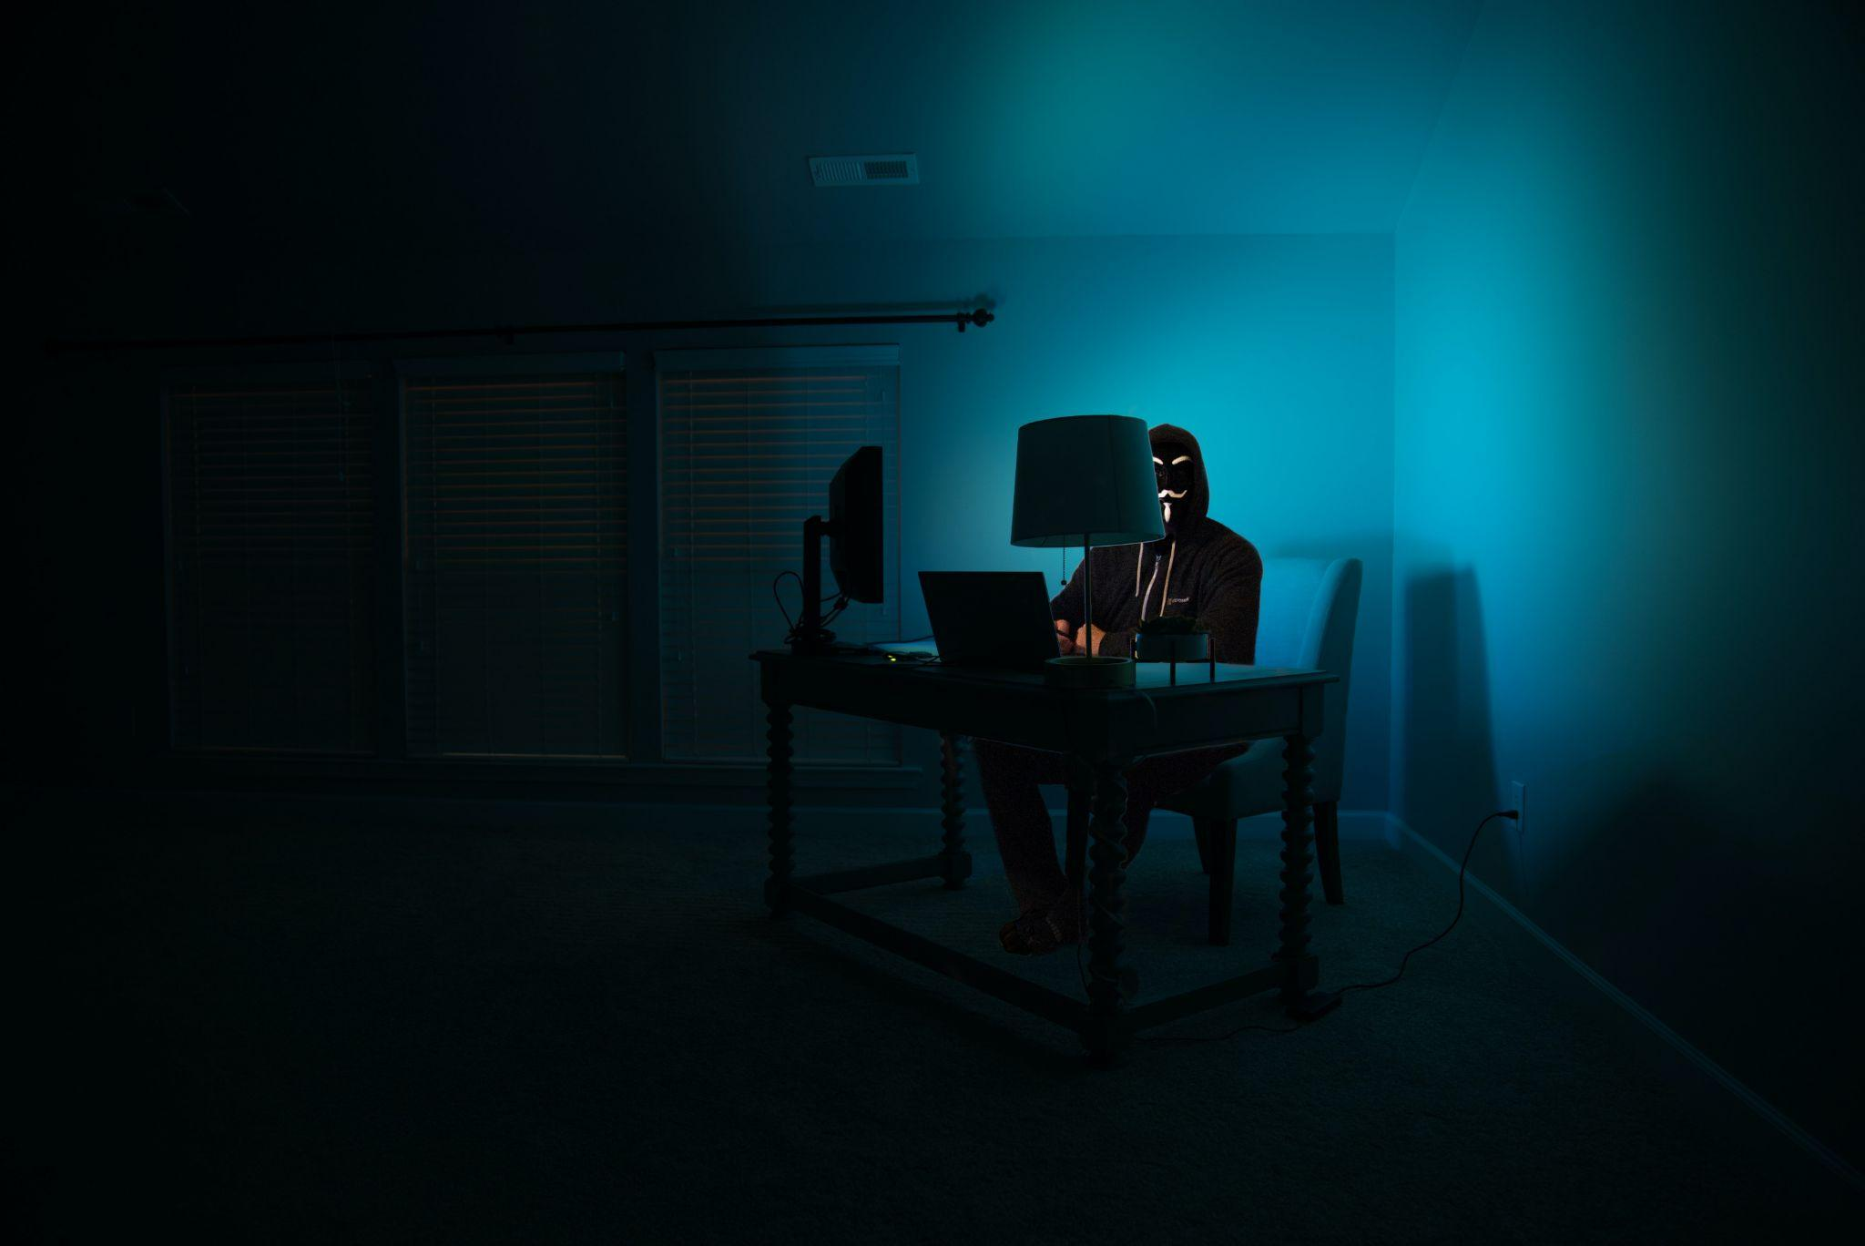
Photo by Clint Patterson on Unsplash
Photo by Good Faces on Unsplash
Photo by Good Faces on Unsplash

Slide 21
Cybercriminals love a good crisis and uncertainty to manipulate and exploit individuals through cyber-threats, and they also use newly-implemented technologies to try to penetrate a business’s systems. As businesses implement safety strategies in response to the coronavirus pandemic, they must prioritize data protection and cybersecurity concerns to limit their exposure and legal liability.
Green, Caleb L. Jodka, Sara H.
“COVID-19 Poses Increased Cybersecurity Risks to Employers and Businesses”
https://www.dickinson-wright.com/news-alerts/covid19-poses-increased-cybersecurity-risks

Slide 22
...employees working remotely can create risks to businesses in the following ways: (1) increased risks from remote access, including physical security risks associated with use of company-owned and personal devices; (2) increased phishing and other scams; and (3) violation of industry- and state-specific laws.
Green, Caleb L. Jodka, Sara H.
“COVID-19 Poses Increased Cybersecurity Risks to Employers and Businesses”
https://www.dickinson-wright.com/news-alerts/covid19-poses-increased-cybersecurity-risks

Slide 23
How COVID-19 changed our thinking on security

Slide 24
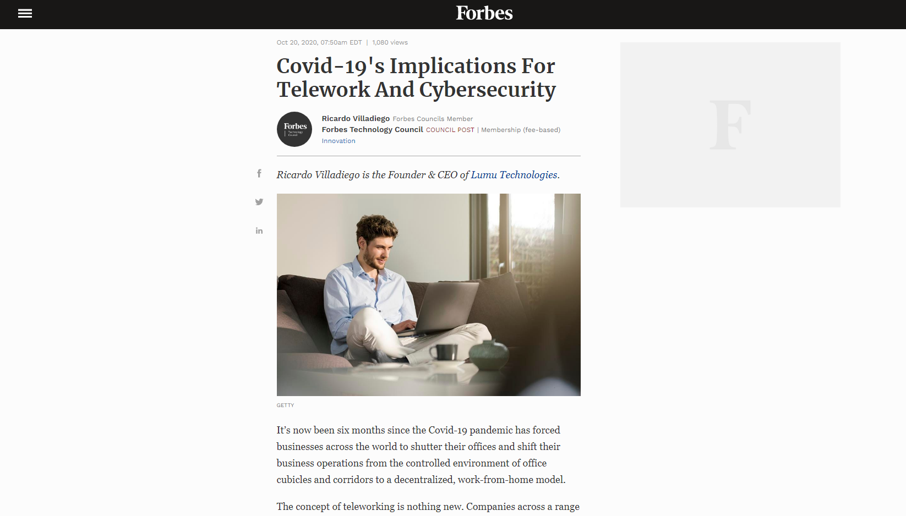
https://www.forbes.com/sites/forbestechcouncil/2020/10/20/covid-19s-implications-for-telework-and-cybersecurity/

Slide 25
The Tip of the Proverbial Iceberg...
After WFH became “the new normal” shortly after the onset of the COVID-19 pandemic, Forbes cited the results of a June 2020 poll of over 350 cybersecurity executives about what new challenges they were facing.
The results were rather telling...

Slide 26
The Tip of the Proverbial Iceberg...
Approximately 1 in 3 respondents stated their company’s ability to detect potential threats was either reduced or completely lost.
70 percent of respondents stated they saw an increase in attacks against their networks.
35 percent of respondents stated they had to reduce their security budgets due to the pandemic.³
³https://lumu.io/wp-content/uploads/2020/07/the-impact-of-covid-19-on-cybersecurity-survey-results.pdf

Slide 27
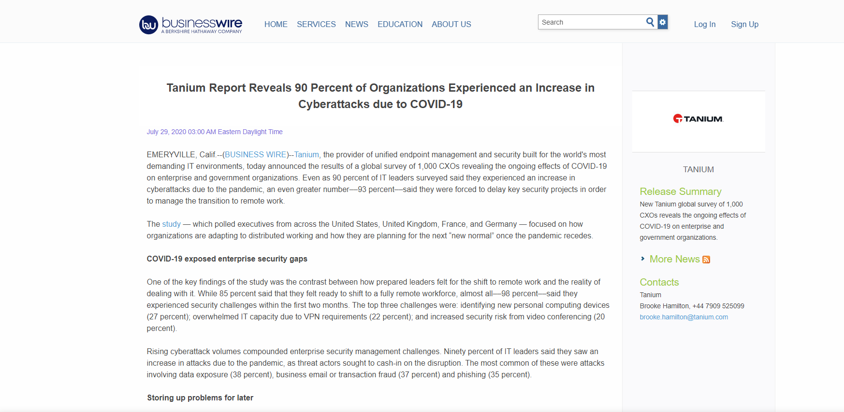
https://www.businesswire.com/news/home/20200729005208/en/Tanium-Report-Reveals-90-Percent-of-Organizations-Experienced-an-Increase-in-Cyberattacks-due-to-COVID-19

Slide 28
Just how big is that iceberg…?
BusinessWire cited a Tanium June 2020 poll of over 1,000 CXOs across four different countries (US, UK, FR, DE).
98 percent of respondents stated they had experienced “security challenges” within the first two months after shifting to a completely remote workforce.

Slide 29
Just how big is that iceberg…?
Top three challenges: Identifying new personal devices that could connect to corporate networks, overwhelmed VPNs, increased security risk from video conference apps.
88 percent of respondents stated they had difficulty with patching machines; 43 percent indicated the issue was with patching personal devices.

Slide 30
Just how big is that iceberg…?
90 percent of respondents indicated they saw an increase in attacks.
Top three attacks: data exposure (38 percent), business email/transaction fraud (37 percent), phishing (35 percent)
Nearly 93 percent of respondents indicated they had to “cancel or delay” planned security projects.

Slide 31
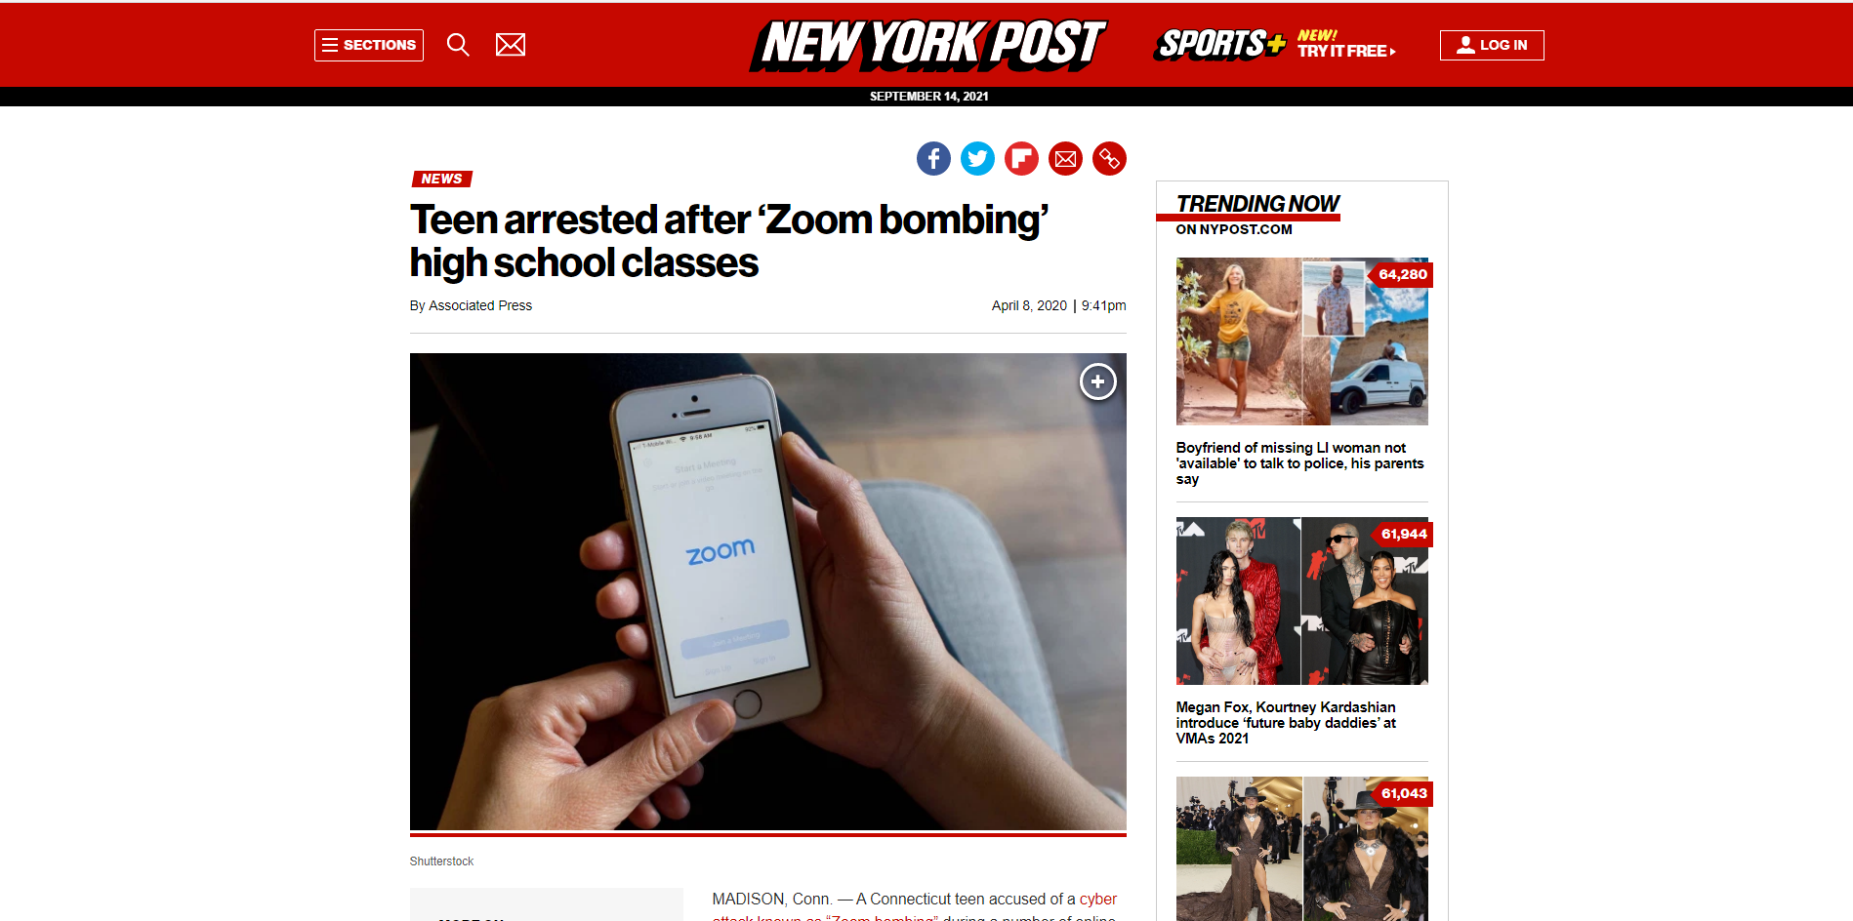
https://nypost.com/2020/04/08/teen-arrested-after-zoom-bombing-high-school-classes/

Slide 32
“Zoom Bombing”
Defined in NYP article as “...an unwanted guest join[ing] a video call with an intention to disrupt and harass.”
Incident occurred early April 2020 @ Madison Public Schools in CT
A CT teen charged w/ fifth-degree computer crime, fifth-degree conspiracy to commit a computer crime and breach of peace.

Slide 33
“Zoom Bombing”
Unauthorized users broke into meetings that migrated to Zoom due to COVID and harass participants.
Meeting links (and sometimes passwords) were published online and were likely picked up by “trolls” and shared in forums such as 4chan or Discord.⁴
Attacks were recorded and published on social media.⁵
⁴https://www.pcmag.com/news/students-conspire-in-chats-to-zoom-bomb-online-classes-harass-teachers
⁵https://www.businessinsider.com/aa-intergroup-meetings-zoom-bombing-trolls-alcoholics-anonymous-2020-3

Slide 34
“Zoom Bombing”
FBI office in Boston issues warning, recommending use of passwords, waiting rooms, not publishing links on public social media, and set screen share to host-only.⁶
⁶https://www.nbcnews.com/health/health-news/live-blog/live-coronavirus-updates-trump-extends-social-distancing-guidelines-governors-warn-n1171761/ncrd1172401

Slide 35
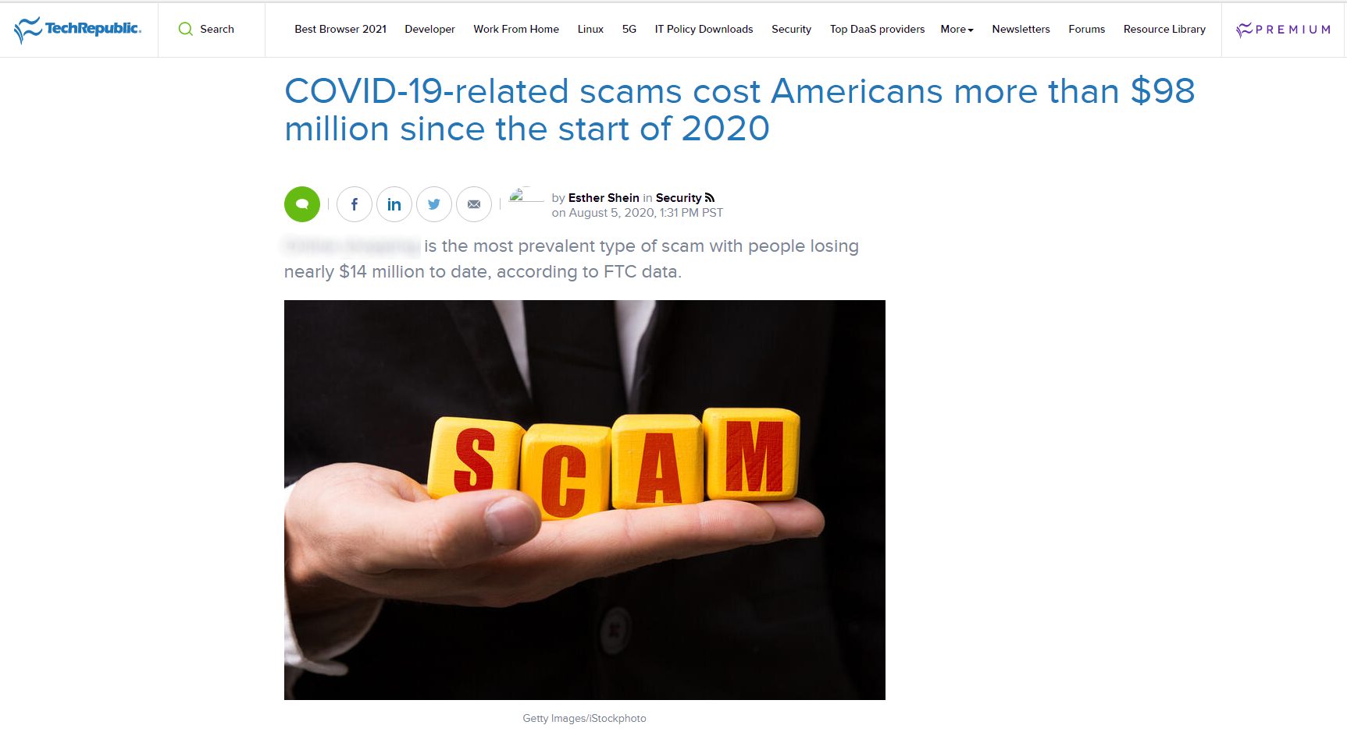
https://www.techrepublic.com/article/covid-19-related-scams-cost-americans-more-than-98-million-since-the-start-of-2020/

Slide 36
Online Fraud
From Jan 2020 to Sep 2021 over 363,000 coronavirus-related fraud cases were reported to the FTC.⁷
More than $558.67M was lost due to fraud.
Online shopping was the most common attack vector (fake supplements, defective masks).
⁷https://public.tableau.com/app/profile/federal.trade.commission/viz/COVID-19andStimulusReports/FraudLosses

Slide 37
Online Fraud
Second most-common attack vector was vacation and travel (over 45K reports, ~$80M in losses).
Top three contact methods: email, website/apps, text messages
Top three payment methods: credit cards, debit cards, payment apps or services

Slide 38
Online Fraud
Largest age group affected were individuals aged 30-39 (over 21K reports), followed by 40-49 year-olds and 50-59 year-olds.
Individuals aged 60-69 suffered a combined $107.6M in losses.
The median loss for individuals aged 80 and over was ~ $1,000.

Slide 39
Are businesses still liable…?

Slide 40
Do the rules still apply?
The short answer is “Yes”.
For example, the California Consumer Privacy Act (CCPA) which went into effect on July 1, 2020, require businesses who receive a notice of alleged violation have 30 days to resolve the incident (“cure”) or face additional actions, such as being assessed civil penalties.⁸
⁸https://leginfo.legislature.ca.gov/faces/codes_displayText.xhtml?division=3.&part=4.&lawCode=CIV&title=1.81.5

Slide 41
Do the rules still apply?
Another example would be a patient with a COVID-19 diagnosis. The US Dept of Health and Human Services (“HHA”) has released guidance on COVID-19 disclosures and violations are still enforceable by penalties and fines.⁹
⁹https://www.hhs.gov/sites/default/files/february-2020-hipaa-and-novel-coronavirus.pdf

Slide 42
Do the rules still apply?
Under GDPR, the status of individuals would qualify under “special categories of personal data”. Specific guidelines for this type of data would need to be adhered to.ª
ªhttps://www.natlawreview.com/article/privacy-hipaa-security-and-gdpr-covid-19-considerations

Slide 43
How do we fix it?

Slide 44
CISA (Cybersecurity & Infrastructure Security Agency) recommendations
Avoid clicking on links in unsolicited emails
“Trust, but verify.” Confirm with the person who sent the email before opening the email attachment.
Use trusted sources for up-to-date info about COVID-19.
Don’t disclose personal or financial information in emails.

Slide 45
CISA recommendations
Before making a donation to a charity or other non-profit organization, ensure that they are a legitimate group.^{b}
Ensure remote access systems are fully patched and are tested for capacity.
Improve system and network monitoring.
Implement multi-factor authentication.
Test your BCDR plans and update if needed.^{c}
^{b}https://www.natlawreview.com/article/privacy-hipaa-security-and-gdpr-covid-19-considerations
^{c}https://www.cisa.gov/sites/default/files/publications/20_0306_cisa_insights_risk_management_for_novel_coronavirus.pdf

Slide 46
Things that I learned...
Always be thinking ahead. If Cloud computing is the end-goal, have a solid migration plan in place.
Not all applications will be lift-and-shift ready. Verify that your apps will function properly in the Cloud.
Small pieces. Don’t move all your data at once.

Slide 47
Things that I learned...
RBAC (or ABAC) over individual user policies.
Educate, educate, educate. Helping to educate others about the need to stay vigilant is good, but not to the point where they become desensitized.
Be flexible when working with other teams or groups. They may not be adjusting as well as you.

Slide 48
Your turn!

Slide 50
Acknowledgements

Slide 51
Thank you to...
BSides Idaho Falls
College of Eastern Idaho
Cvent
SlidesCarnival (slide template)
Twitch community (HauxMaux, the_don_sosa)
Bethesda Softworks
Unsplash
...and all of you.

Slide 52
Thanks!
Any other questions?
You can find me on Twitter: @ProfKilroy
Alt. Twitter account: @Cloud4n6CTF
(You can also find me on LinkedIn.)

